Slide 1

Amazon Fine Food Reviews
Group Members: Qinhuai Gong, kefan zha, chongdi fu, bingyue zeng

Slide 2
Background & Purpose
Amazon credits recommender systems with 35% of their revenue. They credit recommender systems with a 29% increase in total sales, bringing their yearly sales volume in 2016 up to 135.99 Billion.
Build user-based top-10 and item-based top-10 recommendation systems
Shopping websites keep showing correct recommended products for a customer

Slide 3
Data Description
Data source: https://www.kaggle.com/snap/amazon-fine-food-reviews
Data size: 301 MB (10 columns * 568,454 rows)
Data information: 568,454 reviews, 256,059 users, 74,258 products, 260 users with more than 50 reviews
Important variables: ProductID, HelpfulnessNumerator, HelpfulnessDenominator, Rating Score, Review

Slide 4
Methodology
Data preprocessing
Sentiment analysis
Key word frequency
Recommendation system
Evaluation
Overall Result
ALS Algorithm
Popularity Algorithm

Slide 5
Data Preprocessing
Discard user ID and product ID
Create new user ID from 1 to 256,058
Create new product ID from 300,000 to 374,257
Pair up new features with old features and make them integer type
80% training, 20% testing

Slide 6
Problem Statement
What words tend to indicate positive and negative reviews?
It can be easier for customers to filter out the advantages and the disadvantages of the product.
What types of food products get reviews the most?
It can provide some of the most popular products for customers
What makes a review helpful?
The review will be shown at the top if a customer really wants to share experiences and got the highest review’s score

Slide 7
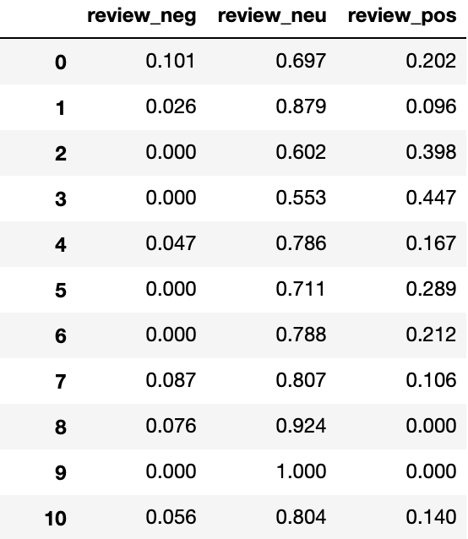
Sentiment Analysis
If there is a correlation between review polarity score and customer rating
Use package NLTK to extract polarity score from each review in the ‘Text’ column
review_neg, review_neu, review_pos

Slide 8
Methodology
Data Preprocessing: Dealing with the missing data by SPSS
Model Building:
Supervised Learning: Decision Tree, Neural Network, Naïve Bayes
Training Data: 70% & Testing Data: 30%
Text Analytics Model: Sentiment Analysis, Topic Modeling, Word Frequency with NLTK.

Slide 9
Expected Result
A ranking list of word will be shown to indicate the positive or the negative reviews
A chart will show some of the most popular product in Amazon fine food
Different models’ accuracy on predicting the positive and negative reviews so that we can choose the model with the highest predictive accuracy

Slide 10
Thanks

